Slide 1
Embedded Systems Project Resturant
Issa Haddad – 47102
Firas Sardast – 47500

Slide 2
Components Used:
Serial Communication Interface
LCD display
DC Motor
DC Fan
External LED’s
Potentiometer
Port-H interrupts
Built-in Keypad
Temperature sensor
ATD coverter

Slide 3
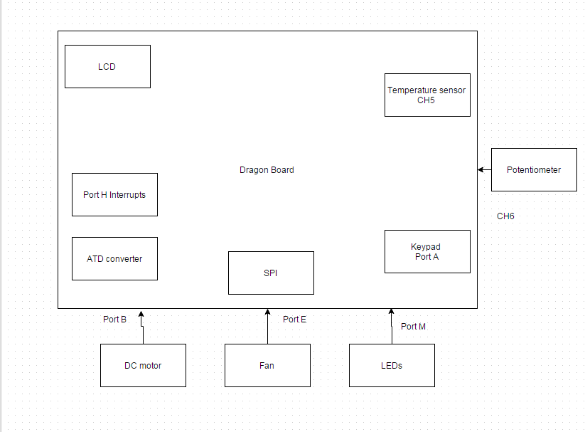
Block Diagram:

Slide 4

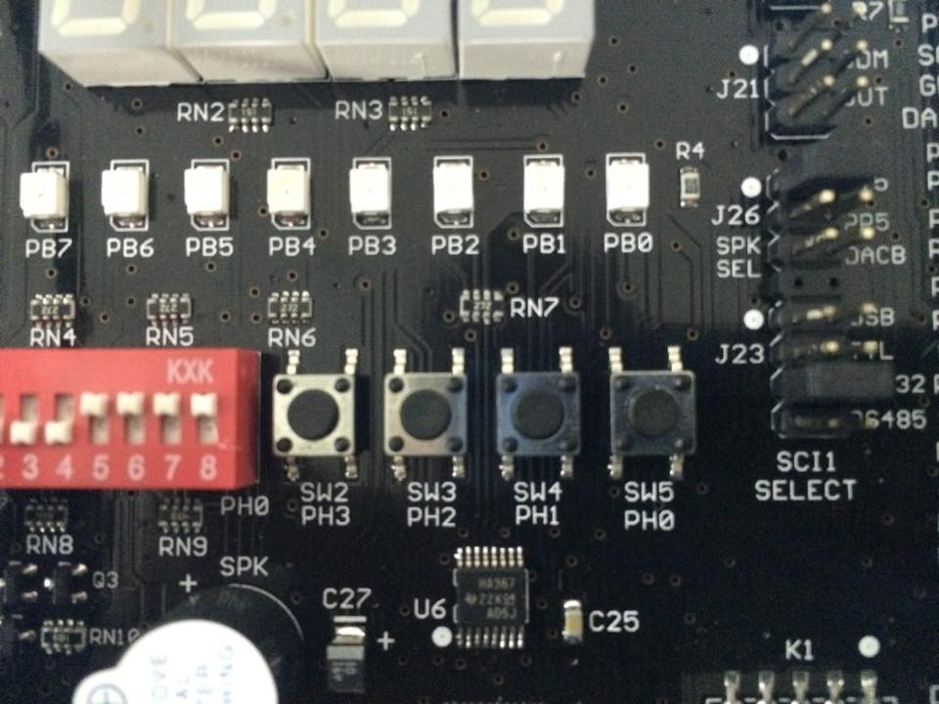
How it works:
Customer enters restaurant to sit on either of the four available seats using any port-H interrupt. He waits as the waiter approaches to give him the menu.

Slide 5
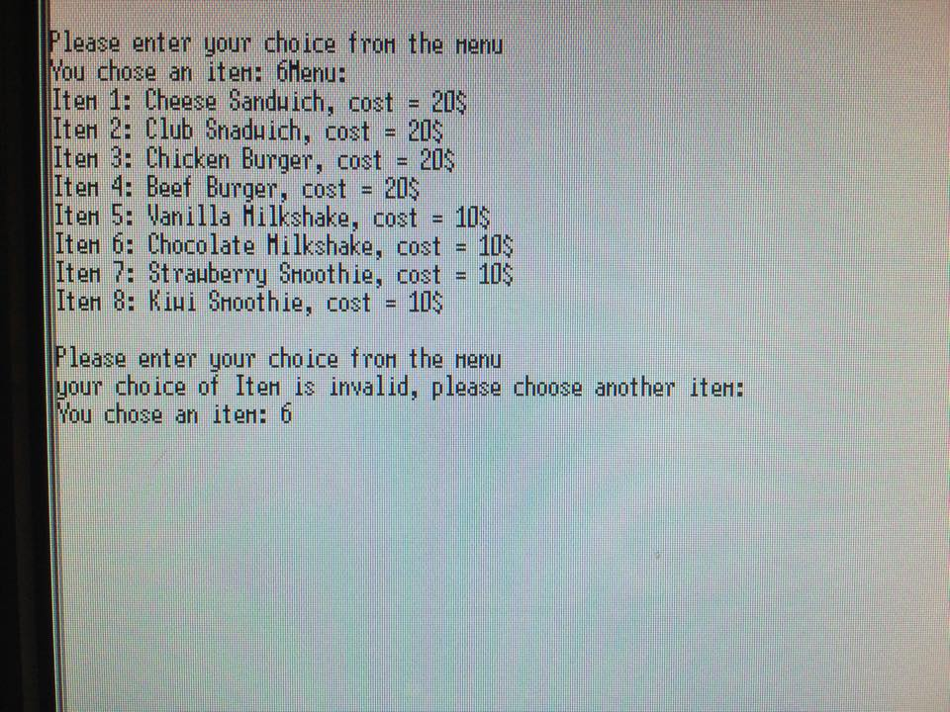
How it works:
Customer views the Menu through the SCI, then picks any item he wants to eat.

Slide 6
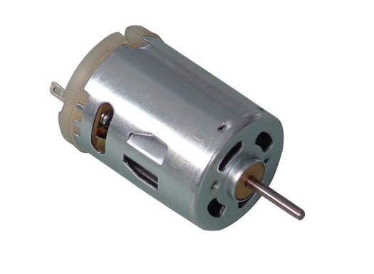
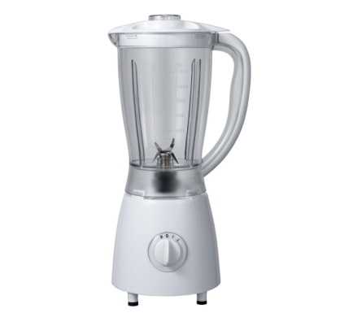
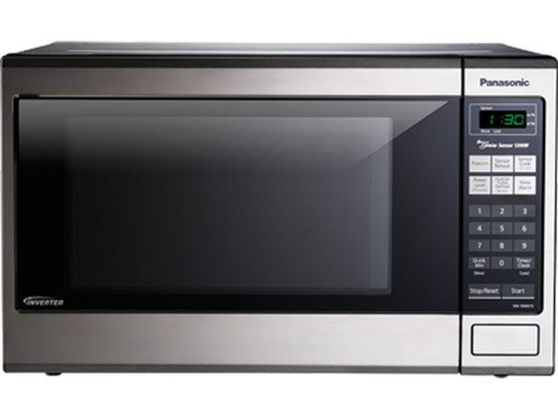
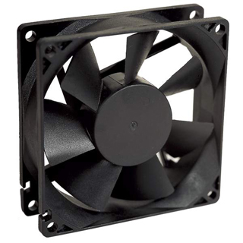
How it works:
If he Orders a drink, a motor will simulate a blender
If he Orders a meal, a fan will simulate a microwave.

Slide 7
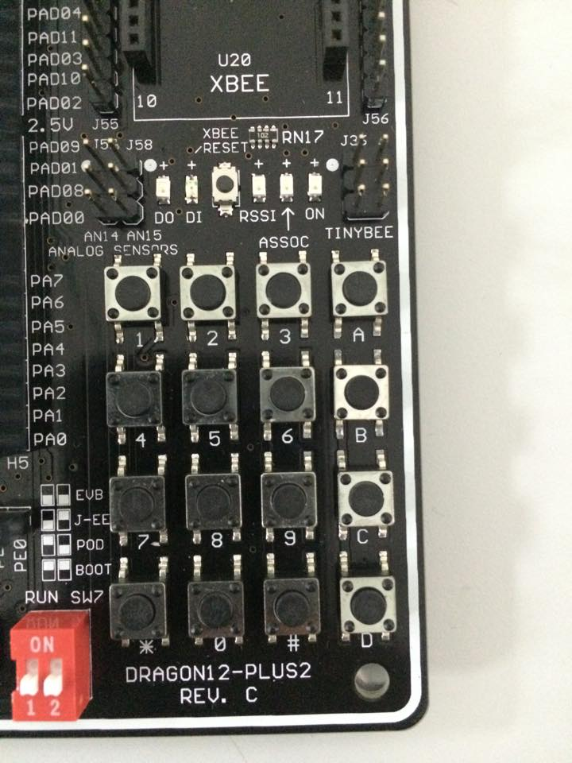
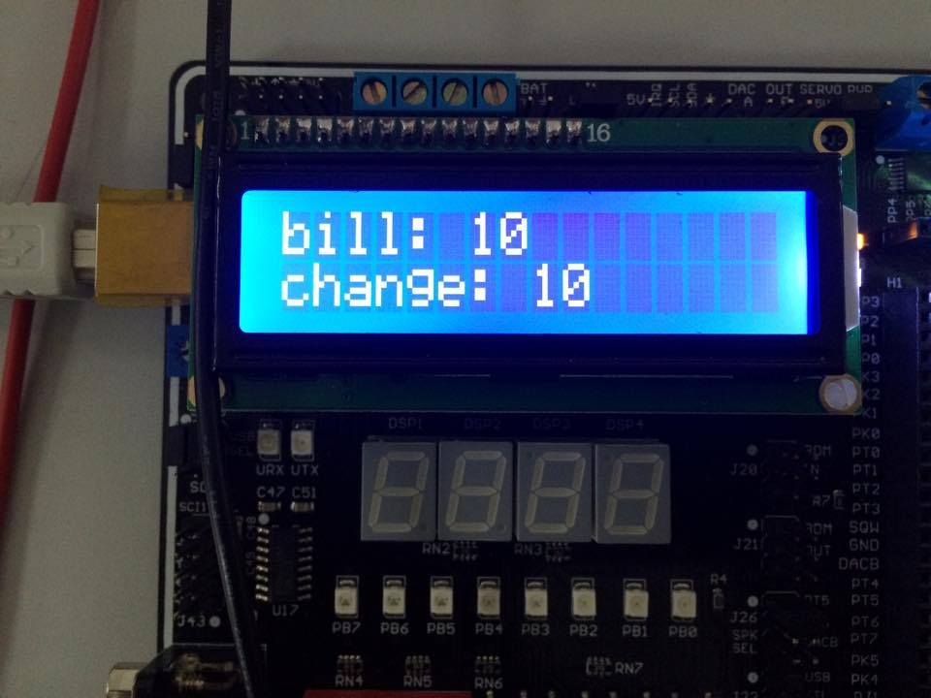
How it works:
After the customer finishes, he presses the same interrupt to order the bill which is displayed on the LCD. The user pays through the keypad.

Slide 8
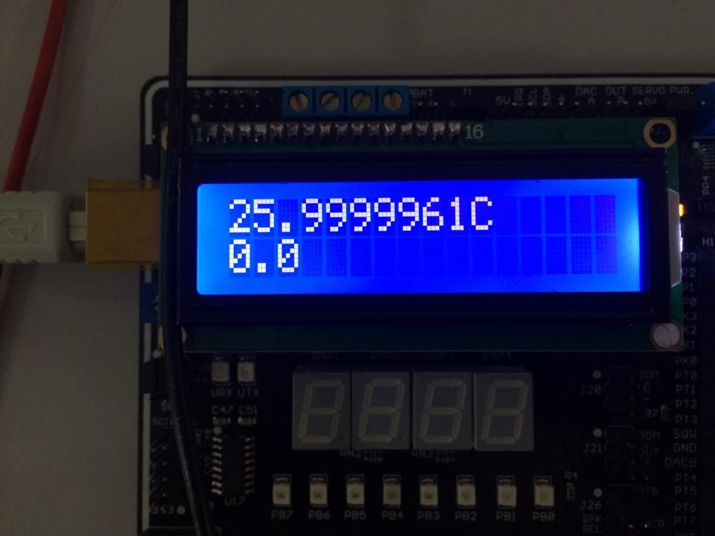
How it works:
The temperature is continuously displayed on the LCD to inform customers about the weather, value for the potentiometer is also displayed

Slide 9
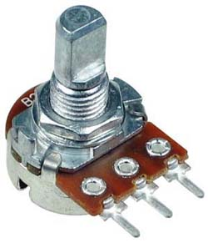
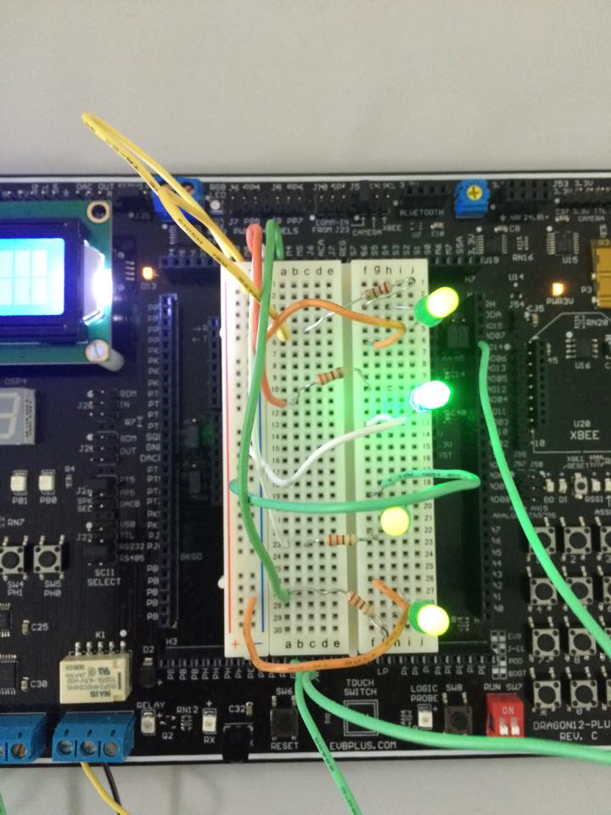
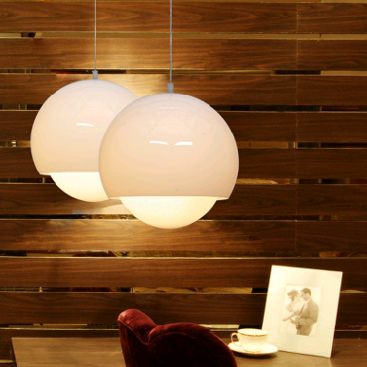
How it works:
Using the potentiometer, we will light an external led for each table. This will resemble the light on each of the four tables.

Slide 10
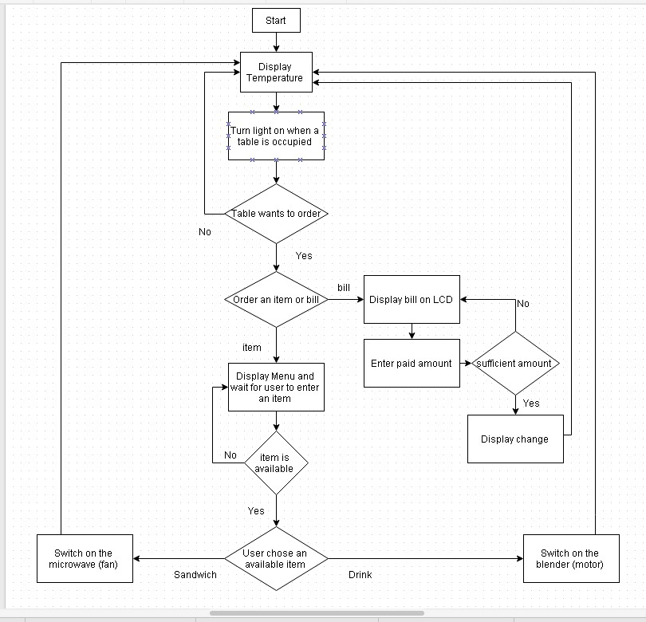
Flowchart:

